Slide 1


BIG DATA ANALYTICS
EDA OF WORLD GDP BY COUNTRY: 1960 - 2022
Jebe Dela Peña
Exploratory Data Analysis
BS CpE 3-2

Slide 2

Overview
GDP is a significant economic measure which illustrates a nation's economic performance and condition. It incorporates the complete monetary worth of all commodities and services produced inside a nation's borders over a certain period of time.
Project Objectives
Global GDP Analysis: Analyze the trajectory of world economic development in order to identify the broad patterns influencing it and discover the yearly variations in the global economy's growth, identifying critical junctures of expansion or decline.
Global GDP Distribution (2022): Identify the economic powerhouses and rising markets by examining the GDP distribution among the top 10 countries, the Philippines, and other countries in 2022.
Philippine Economic Growth (1960–2022): Examine the GDP growth rates for the Philippines over a period of six decades, identifying prevailing historical economic trends and their underlying causes. Investigate the GDP growth rates during several Philippine presidential periods to learn more about how the country's economic policies have affected its prosperity.
Scope and Limitations

Slide 3



Analysis Process
1 - Understanding the Data
Data Familiarization: Having a thorough understanding of the rows, columns and data types which composed the dataset.
Domain knowledge: Applying knowledge of global economics to assess the relevance of GDP numbers, and economic trends.
2 - Data Cleaning
Rows: 266 Rows
Countries and Classifications
Columns: 65 columns
Country
Country Code
Years: 1960 to 2022
Identifying Columns with Missing Values
Identifying and Removing Duplicate Rows
Dropping Rows with All Missing Year Values
Removing Non-Country Entries:
3 - Data Visualization
Line Chart: Visualize trends in global GDP, annual growth rates, and Philippines' GDP over the years.
Bar Chart: Compare GDP values across different countries and presidents' terms in the Philippines.
Pie Chart: Illustrate the proportion of GDP distribution in 2022 among top countries, the Philippines, and other countries.

Slide 4
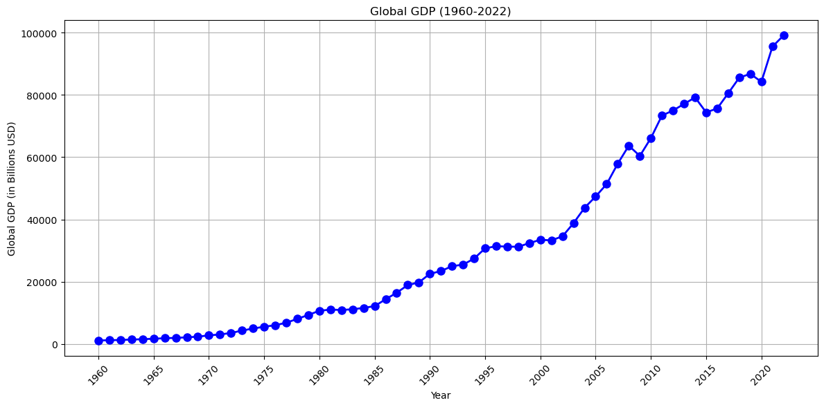
steady upward trajectory, which highlights the overall expansion of the global economy, is a notable aspect.
In a normally increasing trend, periods of drop stand out as minor setbacks, particularly during economic recessions and global crises.
Analysis/Findings:

Slide 5



Insights - Global GDP over the years
Continuous Economic Growth
Cylical Nature
Socioeconomic
Progress
Economic downturns, while concerning, are part of the cyclical nature of economies. For policymakers to execute targeted actions during recessions and take advantage of periods of fast expansion, they must have a thorough understanding of these cycles.
The overall rising trend is driven by advances in technology, education, and healthcare as well as economic growth, signaling broader advancements in society.
The steady upward movement represents the resilience of the world economy, illustrating its capacity to overcome obstacles and adjust to ever-shifting circumstances.

Slide 6
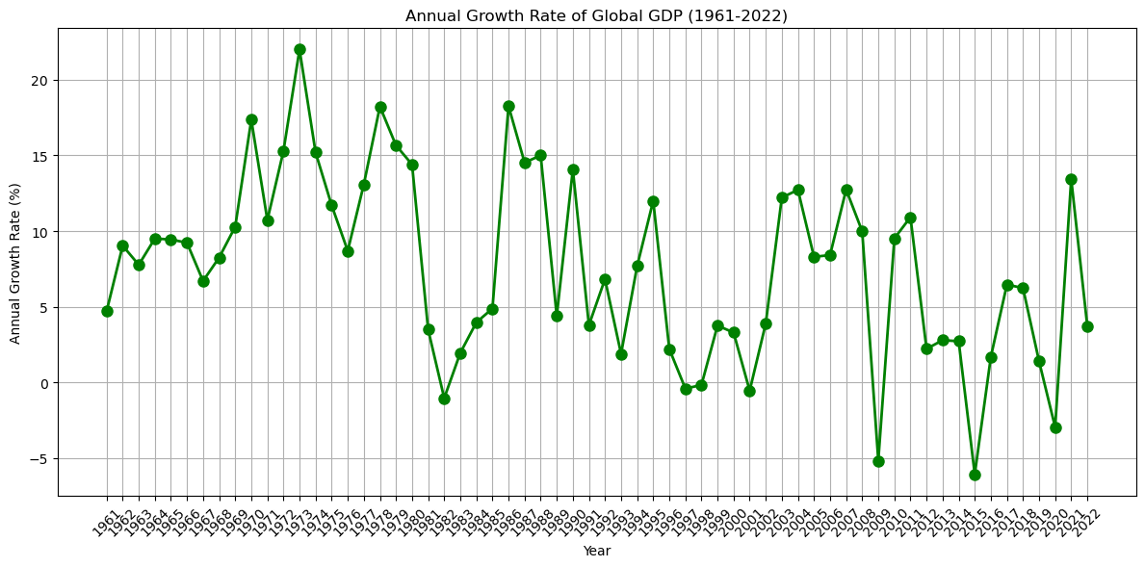
Significant rises can be seen in 1973, 1978, 1986, and 2001.
Notable decreases in 1981, 2009, 2015, and 2020 signify periods of economic contraction.
Analysis/Findings:

Slide 7
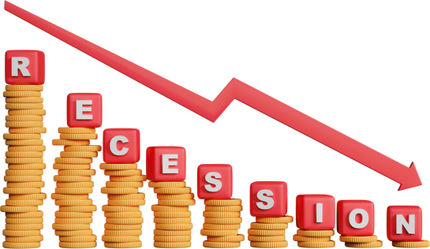


Insights - Annual Growth Rate of Global GDP
2009
Great Recession
2015
Demographic Cliff
2020
COVID-19 Pandemic
It was brought on by the American housing market bubble's collapse. Financial institutions had made significant investments in securities backed by mortgages that contained loans with high risk. It suffered extraordinary losses as a significant portion of these loans went bad, which led to a series of collapses.
In 2015, the global economy was significantly hampered by demographic changes. In many nations, aging populations resulted in lower labor force participation and higher dependence ratios, which had an effect on economic production
The COVID-19 pandemic caused unmatched disruptions to the world economy in 2020. Lockdowns, travel restrictions, and supply chain disruptions had a significant negative impact on economic activity in all sectors.

Slide 8
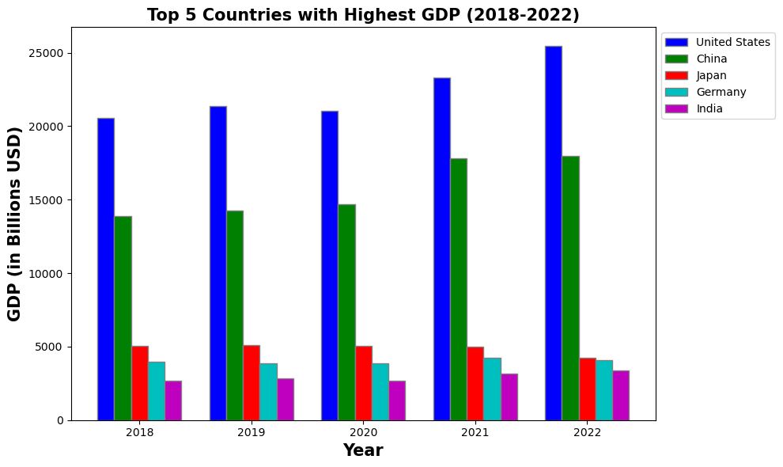
The graph showing the GDP of the top five nations over the past five years—the United States, China, Japan, Germany, and India—displays severe economic differences.
Analysis/Findings:

Slide 9





Insights - Top 5 Countries in the last 5 years
The United States has a varied economy that is supported by technological innovation and entrepreneurship. Some of the biggest technology corporations in the world call it home, greatly boosting its GDP.
United States
Manufacturing and Export Powerhouse: The world's largest manufacturing sector is the foundation of China's economic success. It has a substantial industrial base and a vast network of facilities, making it a hub for exports on a global scale.
China
Technological Innovations and an Export-Oriented Economy: Japan is well known for its technological innovations, particularly in the fields of electronics and autos. Japan retains a strong export-oriented economy despite an aging population.
Japan
Exports and Engineering Excellence: Germany is known for its superior manufacturing and engineering capabilities. It leads the world in the export of vehicles, equipment, and business supplies
Germany
Service-Oriented Economy and IT Hub: India's service sector, notably information technology (IT) and software services, is the country's economic growth engine. The nation provides IT services to large international organizations and is a popular outsourcing location.
India

Slide 10
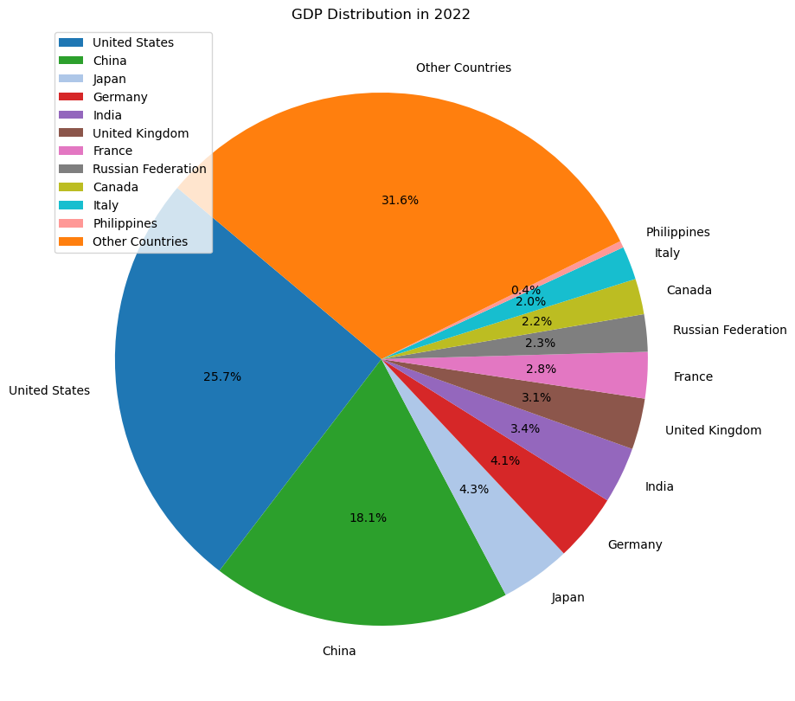
Analysis/Findings:
United States Dominance: With a 25.7 percent share of the global economy, the United States continues to be the world's economic leader.
Diverse European Contributions: With a combined 12.2 percent contribution, European nations including Germany, the United Kingdom, France, and Italy highlight the continent's economic diversity.
Philippines Contribution: Despite being considerably less significant, the Philippines' 0.4% contribution still reflects its position within the global economic system.
Other Countries: The category "Other Countries" accounts for 31.6 percent of the total GDP, highlighting the economic output of several countries besides the top 10 and the Philippines

Slide 11


Insights - GDP Distribution in 2022
US-China Hegemony
European Influence
With a combined share of 43.8 percent, the United States and China are once again the world's two most powerful economies. Their economic decisions, trade relations, and policies have a big impact on international markets and global economic trends.
The significant contributions from Germany, the United Kingdom, France, and Italy demonstrate the region's economic sway. The European Union continues to be a crucial economic force that influences international trade and financial markets

Slide 12
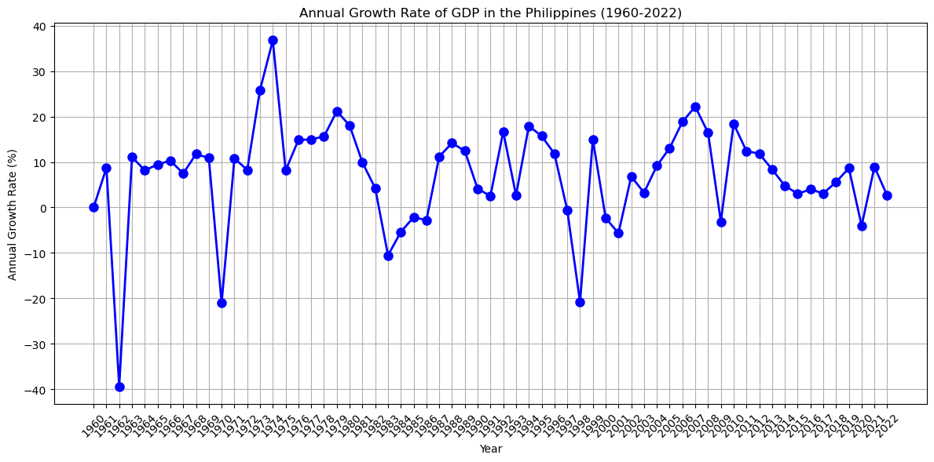
Notably, in 2015, despite a substantial global economic slowdown, the Philippines showed resilience by maintaining a positive GDP growth rate.
Significant downturns in 1962, 1970, 1998, and 2009 reflect difficult times.
Analysis/Findings:

Slide 13



Insights - Philippines Annual Growth Rate of GDP
Economic Diversification
Global and Regional Economic Development
Setbacks and Obstacles
Phases of strong growth correspond to times when the economy is diversifying. During difficult global economic times, policies supporting varied industries like business process outsourcing (BPO), tourism, and manufacturing significantly boosted economic resilience and growth.
Significant downturns in 1962, 1970, 1998, and 2009 reflect difficult times. Economic contractions during these years may be attributed to natural disasters, policy concerns, or worldwide economic recessions, which could have a detrimental effect on consumer and investor sentiment.
The trajectory of the Philippine economy is shaped by external factors such as regional economic stability, global financial and economic crises, and investor confidence.

Slide 14
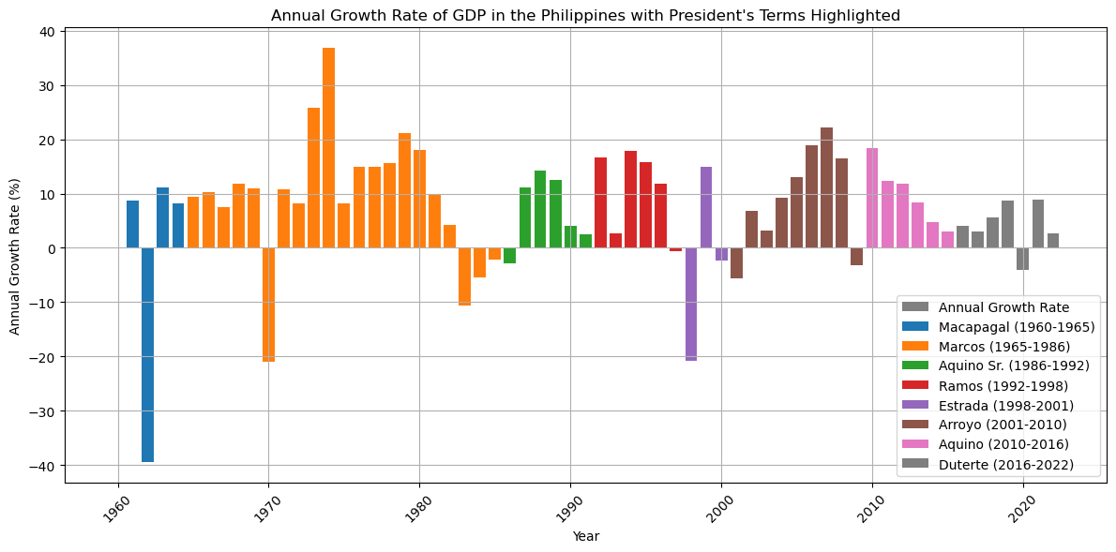
Economic difficulties were experienced during President Macapagal's term, particularly in 1961.
The time of the Aquino administration was characterized by sustained economic growth without significant downturns.
Analysis/Findings:

Slide 15

Insights - Annual Growth Rate of GDP in the Philippines each President's term
The administration went through significant downturns, most notably the one in 1970. The final three years of the Marcos administration saw a drop in GDP growth. Massive lending from commercial banks, accounting for about 62% percent of external debt, also allowed the GDP of the Philippines to rise during martial law.
Marcos
(1965-1986)
Aquino Sr.
(1986-1992)
President Aquino Sr.'s first year in office in 1986 was characterized by political and economic uncertainty as the country transitioned from the previous government. Positive GDP growth in succeeding years pointed to a steady economic recovery.
Arroyo
(2001-2010)
The economic performance of the Arroyo government was mixed. There were difficulties in the first and last year but economic development was evident in the years followed.
The time of the Aquino administration was characterized by sustained economic growth without significant downturns. The GDP performance reflects how pro-business policies, anti-corruption programs, and strategic investments helped to create an environment that was favorable for economic growth.
Aquino
(2010-2016)
Duterte
(2016-2022)
The economic performance of the Duterte government maintained to be lacking of notable GDP changes. The global COVID-19 pandemic caused a dramatic decline in 2020. Supply chains were disrupted and strict lockdowns caused the economy to decline.

